Slide 1
Balloon Shooter
Kyriakos Alexandrou
1127540

Slide 2
Introduction
The project’s aim was to develop an educational game that target maths skills for primary school pupils (up to year 6 – age 10-11).
Kids get bored easily and have low attention span.
Kids prefer interaction in a more fun and entertained way, rather than plain reading.
Therefore a combination of a game and education in maths is a good idea.

Slide 3
Executive Summary
Interaction pattern: Single Player vs game
Genre: Shooting game
The player must shoot the correct balloons that form the result of the current displayed equation.
When the correct balloons are destroyed a new equation becomes visible.
Platform(s): Currently the game is only playable on PC’s using the mouse for interaction. However, as a shooting game that doesn’t have a visible player object, it would make an excellent game for smartphones/tablets (Touch).
Selling Point
Interaction
Learning in a fun way
Competition between kids (high score)
Target Market: Primary school pupils (up to year 6 – age 10-11).

Slide 4
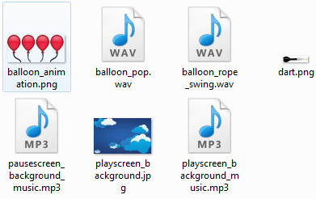
Resources Used

Slide 5
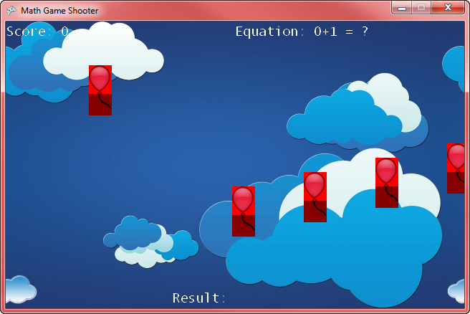
Debugging
Created rectangles for the upper and lower body of the balloon to make sure collisions where correct

Slide 6
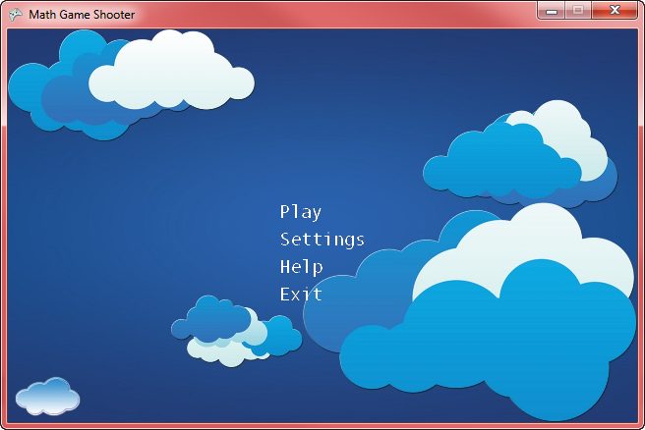

ScreenShots
Menu
Menu on option mouse over

Slide 7
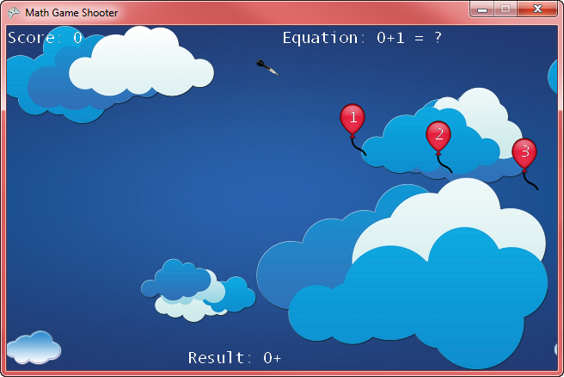
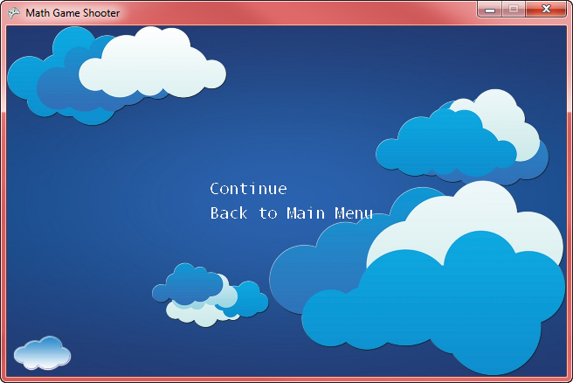
ScreenShots
ScreenShots
Gameplay
Pause screen

Slide 8

Educational Aspect
Testing their math skills as well as getting feedback when someone is weak at specific math skills (sum, minus etc.)

Slide 9
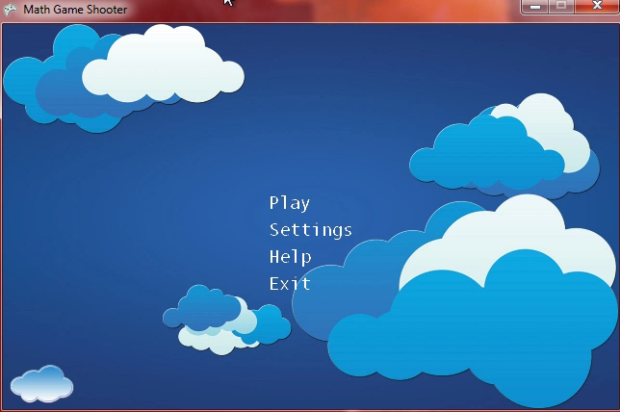
Video Demo

Slide 10
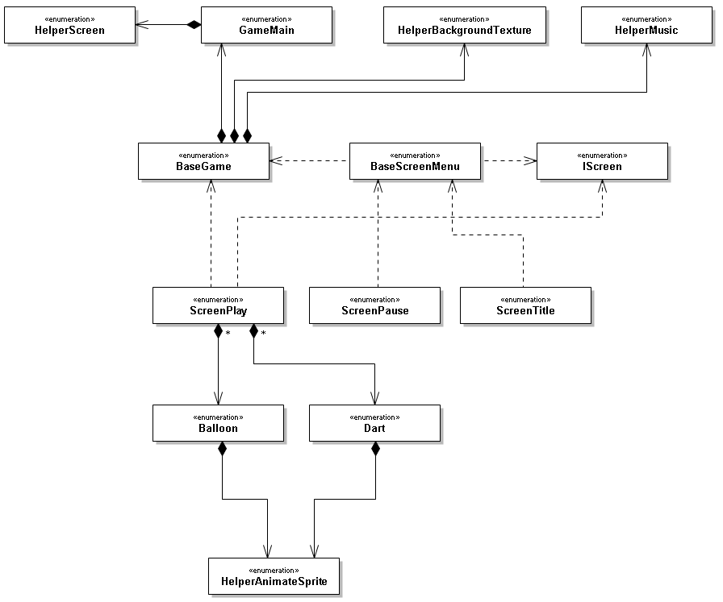
Class Diagram
Example
BaseGame has a:
GameMain
HelperBackgroundTexture
HelperMusic
BaseScreenMenu extends:
BaseGame
And implements:
Iscreen
ScreenTitle extends:
BaseScreenMenu
Classes Description
GameMain: initialises the content pipeline, graphics, FPS.
[A] BaseGame: Has all the basic functions and helper classes that classes inherit.
[A] BaseScreenMenu: Common logic for menu screens.
[I] Iscreen: Screen callback’s for update and draw methods.
ScreenTitle: The main menu screen.
ScreenPlay: The main game screen.
ScreenPause: The pause
screen.
HelperScreen: Holding and changing between screens.
HelperBackgroundTexture: Encapsulates background texture logic.
HelperMusic: Encapsulates music logic.
HelperAnimateSprite: Encapsulates animation logic
Balloon: Animated moving balloon that carries points.
Dart: Animated thrown dart when mouse button is clicked.
A
A
I
A
Abstract Class
I
Interface

Slide 11
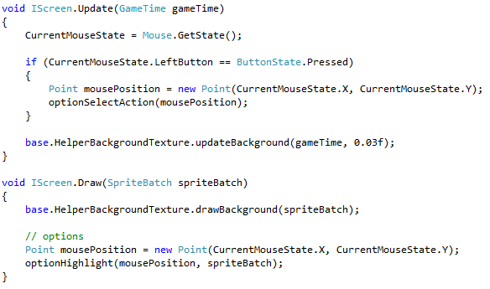
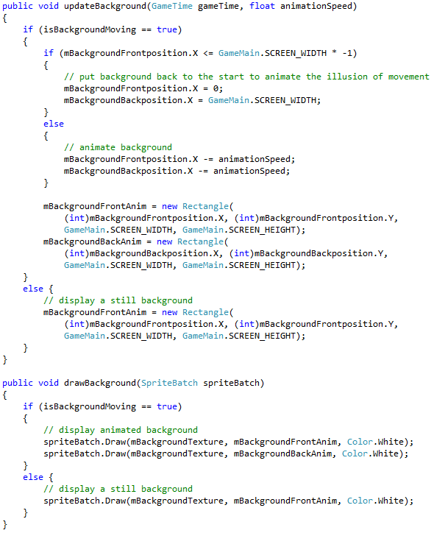
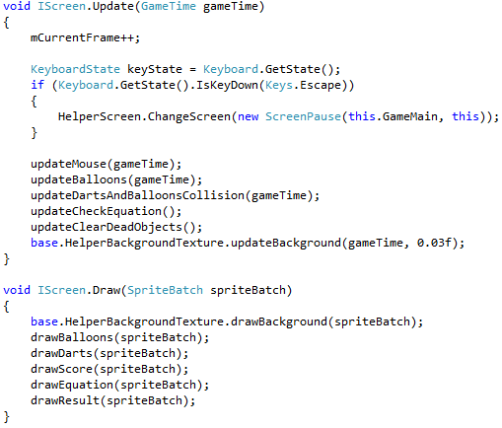
Snippet of Code
BaseScreenMenu.cs
A base class for creating menu screens.
HelperBackgroundTexture.cs
A base class for creating background textures. Based on the given parameters it can be a moving or a still background
ScreenPlay.cs
The main game update and draw methods where everything is working together to make the game playable

Slide 12
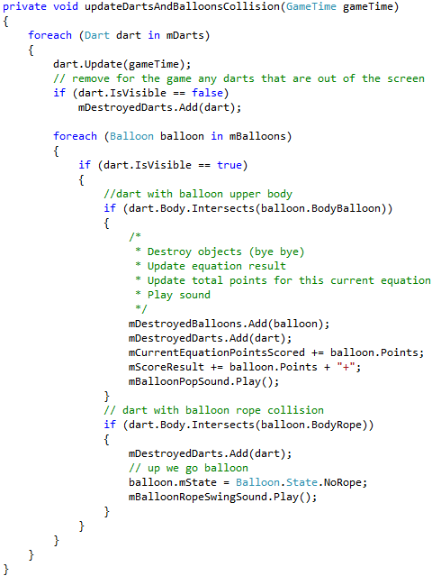
Snippet of Code
Play Screen Collision Method
Destroy the dart if it’s not visible in the screen
Dart collision with balloon upper body
Destroy dart and balloon
Increment current equation result number
Play balloon pop sound
Dart collision with balloon lower body (rope)
Destroy dart
Change balloon state (go up)
Play rope swing sound

Slide 13
Business and Expanding
Expanding the game:
- As a shooting game that doesn’t have a visible player object, it would make an excellent game for PC (mouse) and smartphone/tablet (Touch).
Gameplay:
- Variety of enemies with different skill (more speed, more movement).
- More weapons (arrows, javelin) and powers (touch two fingers on the smartphone screen to fire multiple darts).
- Play modes and difficulties (Arcade, time attack, survival).
- Resources (HP, XP, lives, levels).
- Variety of stages to choose from (moon, field, beach)
Business:
- Parents and schools
- Use a crowdfunding platform

Slide 14
References
Textures
http://www.clipartlord.com/tag/darts-clip-art/ [Accessed December 2nd 2014]
http://www.emojibase.com/emoji/1f388/balloon [Accessed December 2nd 2014]
http://www.wallpaperfinder.com/wallpaper/minimalistic-blue-clouds [Accessed December 2nd 2014]
Sounds and Music
http://soundbible.com/1522-Balloon-Popping.html [Accessed December 2nd 2014]
http://www.stafaband.info/ [Accessed December 18th 2014]
XNA/Monogame Tutorials:
Digital Media & Games Lectures (Alessio Malizia)
Digital Media & Games Lab sheets (Michael Scott)
http://rbwhitaker.wikidot.com/2d-tutorials

